Slide 1
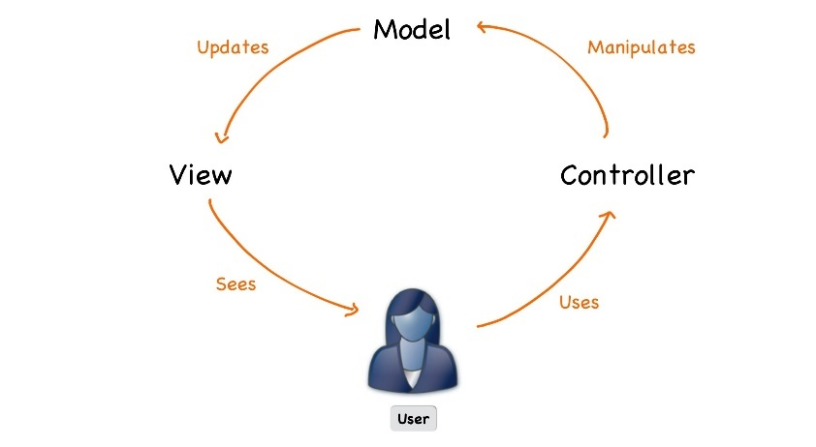

Java MVC Frameworks
Course Introduction
SoftUni Team
Technical Trainers
Software University
http://softuni.bg

Slide 2
Table of Contents
Course Objectives & Program
The Trainers Team
Course Organization
Homework
Project Defense
Resources

Slide 3
Questions
sli.do #java-web

Slide 4

Course Objectives & Program
Java MVC Frameworks

Slide 5


Java MVC Frameworks – Course Program(1)
Course Introduction - Course Program, Trainers, Project defenses, Resources
Spring Boot Introduction - What is SpringBoot?
Spring Essentials - Everything important you need to know
Workshop
Thymeleaf & Controllers - Template engine and controllers
Unit Testing & Isolation - Testing our app
Error Handling - How to handle errors

Slide 6



Java MVC Frameworks – Course Program(2)
JS & AJAX - JS and AJAX
Workshop
Filters & User Authentication - How to secure our app
Integration Testing - Testing our app
Workshop

Slide 7

The Trainers Team

Slide 8
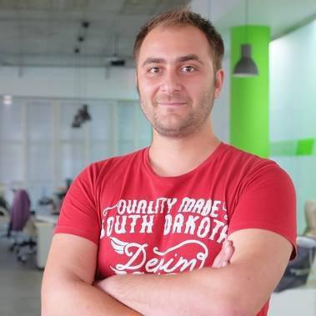
Trainers Team
Doncho Minkov
Senior Full Stack Developer in SoftUni
10+ years in IT
8+ years of experience as a
Technical Trainer @ Telerik Academy
Front-end developer by heart
Software developer by need
Experience with all popular mobile platforms
Android, iOS, Windows
Fluent in Node.js, .NET, Angular, Java, C++
"30 under 30" – Forbes 2017 - Education

Slide 9

Course Organization

Slide 10
Java Web Module at SoftUni – Timeline
17-Sept-2019
04-Nov-2019
15-Dec-2019
Java Web Development Basics
Lessons + exam
6 weeks * 2 times / week
12 credits
Start: 17-Sept-2019
Exam: 03-Nov-2019
Java MVC Frameworks
Lessons + exam
6 weeks * 2 times / week
18 credits
Start: 05-Nov-2019
Project Defense: 15-Dec-2019
Java Web Re-Take Exams
Third week of December 2019

Slide 11



Scoring System for the Course
Theoretical Exam 5%
Project defense 95%
Presence in class 5%
Evaluation

Slide 12

Project
Web project
Implementing a web application using Spring Framework
Project Defense: 15 minutes.

Slide 13
Theoretical Exam
Test for 30 minutes
Multiple-choice with 1 or more correct answers
English
Automated quiz system
Available online the day before the practical exam
You can submit your answer just one time

Slide 14
Resources
Resources
What We Need Additionally?

Slide 15



Java Web Course Web Site, Forum and FB Group
Official web site:
Official discussion forum:
Official Facebook groups:
https://softuni.bg/trainings/2446/spring-mvc-october-2019
https://softuni.bg/forum/categories/72/java-web
https://www.facebook.com/groups/JavaWebSeptember2019/

Slide 16


The Java Web Frameworks Slides and Videos
All lecture slides, videos, homework assignments, projects and other resources are open content, available for free
Visit the course web site to access the course resources

Slide 17



Learn to Search in Internet
The course assignments require to search in Internet
This is an important part of the learning process
Some exercises intentionally have no hints
Learn to find solutions!
Software development includes everyday searching and learning
No excuses, just learn to study!
Developers learn new technologies, tools, languages every day!

Slide 18
https://softuni.bg/trainings/courses

Slide 19












SoftUni Diamond Partners

Slide 20




SoftUni Organizational Partners

Slide 21




Trainings @ Software University (SoftUni)
Software University – High-Quality Education and Employment Opportunities
softuni.bg
Software University Foundation
http://softuni.foundation/
Software University @ Facebook
facebook.com/SoftwareUniversity
Software University Forums
forum.softuni.bg

Slide 22

License
This course (slides, examples, demos, videos, homework, etc.) is licensed under the "Creative Commons Attribution-NonCommercial-ShareAlike 4.0 International" license

